Slide 1

SKILLSUSA RESUME TEMPLATE WALKTHROUGH

Slide 2
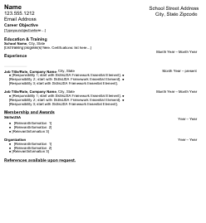
Step One:
Resume Template
Download the SkillsUSA Resume Template
https://drive.google.com/file/d/1Lw7Ov-MlYauYFbZ4BbIMxCGGdmRKm7lA/view
Once it is downloaded, go to your files, and open it in a new tab.

Slide 3

Step 2 - Name/school
Fill out the top section with your personal information. Since this is a SkillsUSA event, the email should be your school email.
Your school Address, City, State, and Zip Code can be found on google.

Slide 4
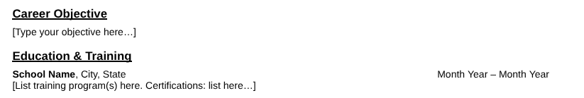
Step 3 - Career Objective and School Experience
Your objective should discuss your goal for a future workplace
Ex: To obtain a challenging position where my technical expertise and artistic skills can be utilized to benefit an organization.
This is where you should put your schools name and how long you have been a student there. You should also list any certifications like OSHA 10 or food safe certifications. DON'T PUT AWARDS! they will be listed in another section.

Slide 5
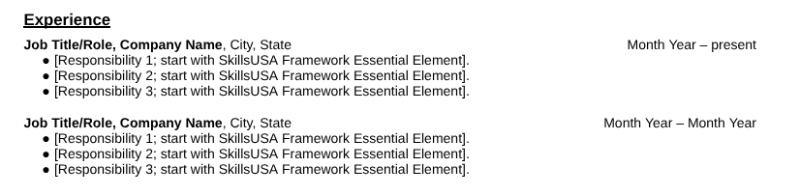
Step 4 - Job/Internship Experience
This section is only meant for internships/jobs. If you have neither, delete the section.
Make sure to tie a responsibility or skill associated with your job to each SkillsUSA framework element. (Personal Skills, Technical Skills Grounded in Academics, and Workplace Skills.) If you are having trouble defining framework elements, Google the SkillsUSA framework triangle.

Slide 6
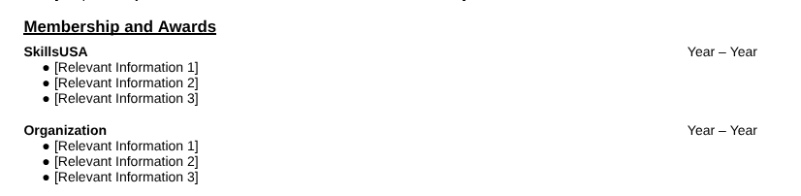
Step 5 - Membership and Awards
The top section should only be for SkillsUSA-related awards. If you are an officer, have been a finalist, or placed first, second, or third in a competition, make sure to include that!
The bottom section can include other school awards and honors (class officers, student of the month, National Honor Society, merit awards).

Slide 7
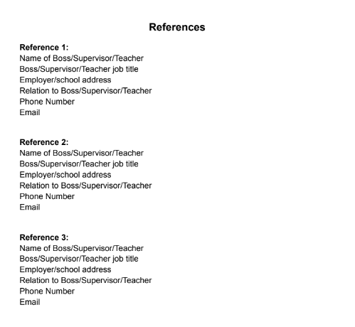
Step 6 - References
A reference page is required only for the Job Interview Competition; however, including one can provide judges with additional insight into your background and qualifications, regardless of which competition you are participating in.
Three references should to included and be formatted like the one pictured.

Slide 8
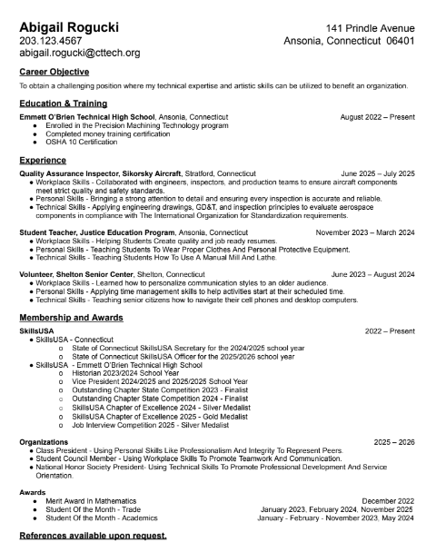
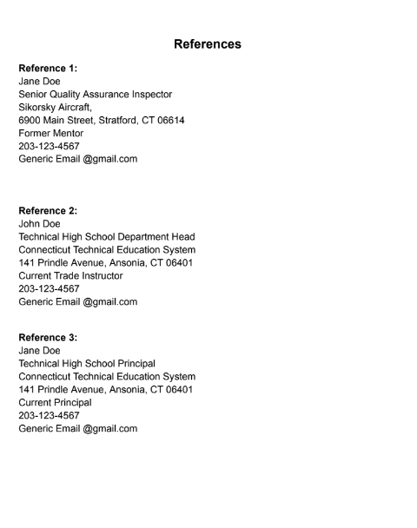
Student Example

